Slide 1
WebGL basics
Introduction to WebGL 3D with HTML5 and Babylon.js

Slide 2


WHO ARE WE?
Geeks, web developers, 3D addicts
DAVID ROUSSET
DAVID CATUHE
TECHNICAL EVANGELIST
PRINCIPAL PROGRAM MANAGER
Twitter: @davrous
http://blogs.msdn.com/davrous
Twitter: @deltakosh
http://blogs.msdn.com/eternalcoding
Do not try to tune your speakers, the weird sound is due to French accent…

Slide 3
AGENDA
1
WebGL 101
2
Understanding geometries and shaders
3
Performance considerations
4
Introducing Babylon.js

Slide 4
Section One
WebGL 101

Slide 5




WebGL is…
A JavaScript API
Based on OpenGL ES 2.0
Standardized by Kronos Group

Slide 6

Using WebGL directly
You need to handle everything except the rendering
You have to:
Create shaders code
Create geometry and topology
Handle textures and resources management
Manage the render loop

Slide 7
SIMPLEST WEBGL CODE EVER
DEMO

Slide 8
Section Two
Understanding geometries and shaders

Slide 9
Geometries
Vertices data (array of numbers)
WebGL Buffer
Faces data (array of numbers)
3D CARD
CPU SIDE
GPU SIDE

Slide 10
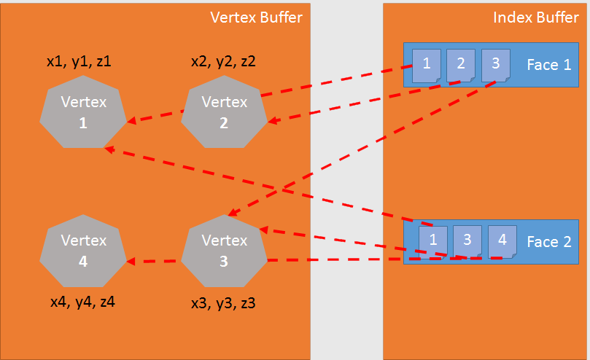

Slide 11
CREATING BUFFER
DEMO

Slide 12
Shaders
Shaders are code for the GPU
Language used is GLSL (Graphics Library Shader Language)
Vertex shaders are about transforming geometry
Pixel shaders are about computing pixel color

Slide 13
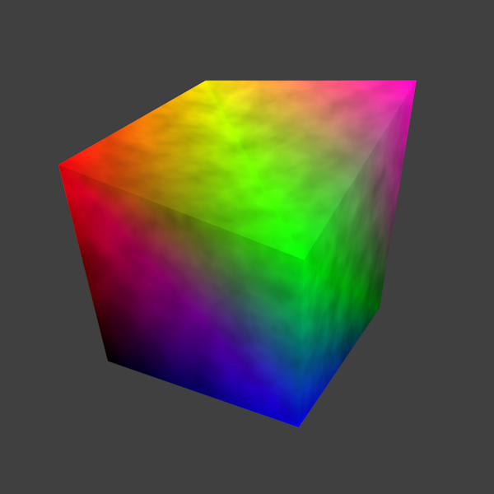
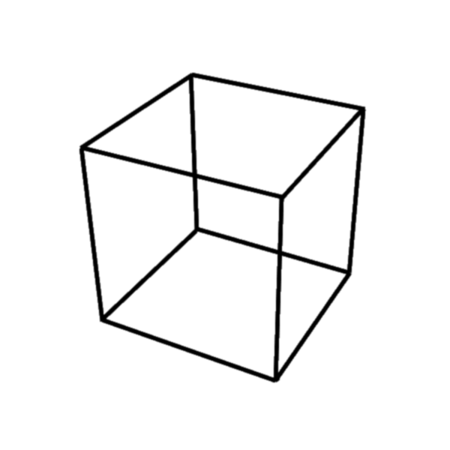
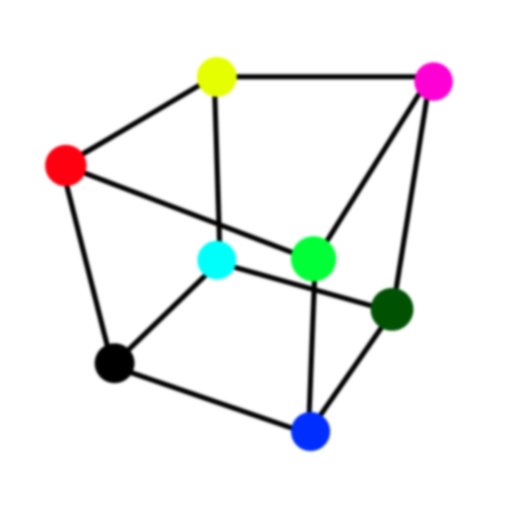
Vertex Shader
Pixel Shader

Slide 14
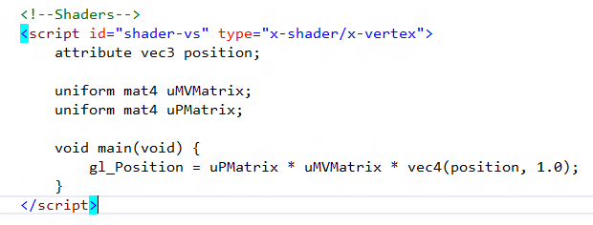
Anatomy of a vertex shader
Vertex data
External constants
Vertex shader code

Slide 15
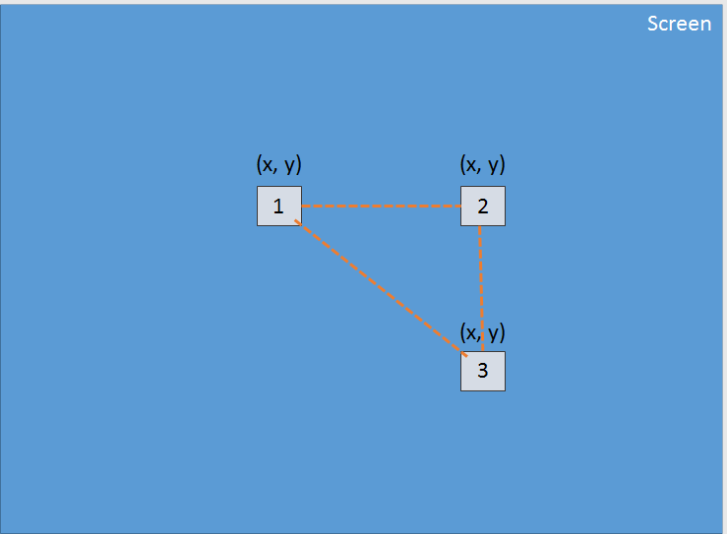

Slide 16
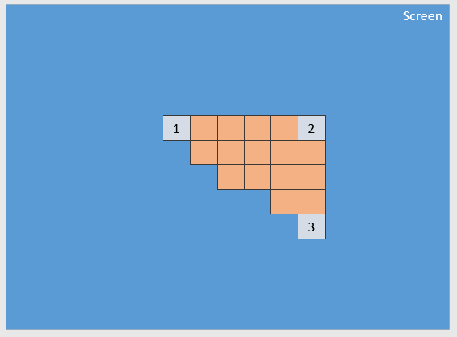

Slide 17
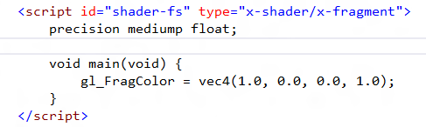
Anatomy of a pixel shader
Pixel shader code

Slide 18
DRAW ME A TRIANGLE
DEMO

Slide 19
Section Three
Performance considerations

Slide 20
Performance first
Going under the hood...
GARBAGE COLLECTOR
STATE CACHING
SMART SHADERS
WebGL is a state machine and changing states is expensive
Removing memory pressure to avoid FPS drops due to GC
Compiling cutting edge shaders

Slide 21
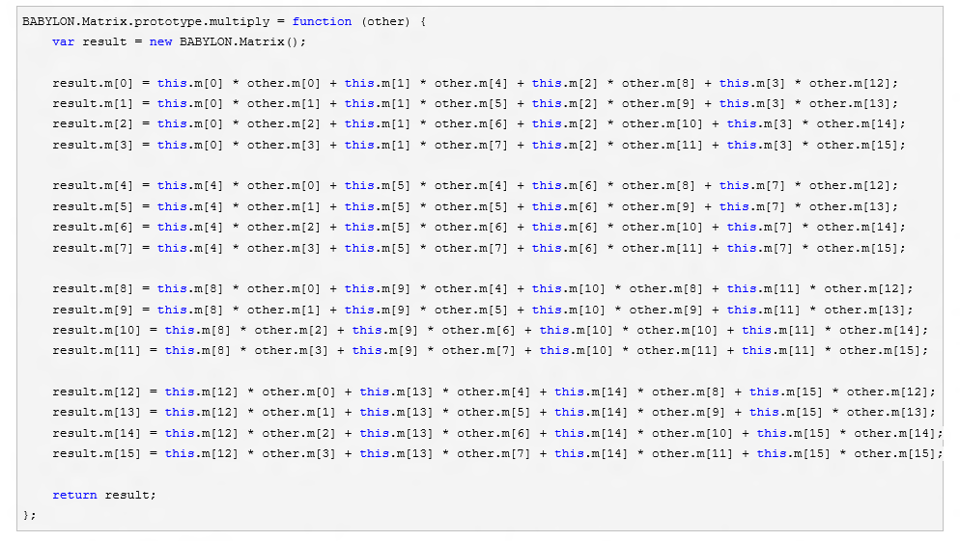
Reducing the pressure on the garbage collector
Removing non required instantiations

Slide 22
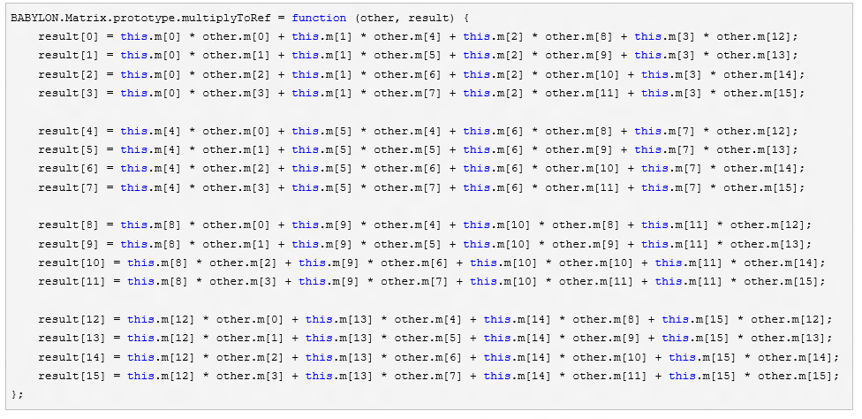
Reducing the pressure on the garbage collector
Removing non required instantiations

Slide 23
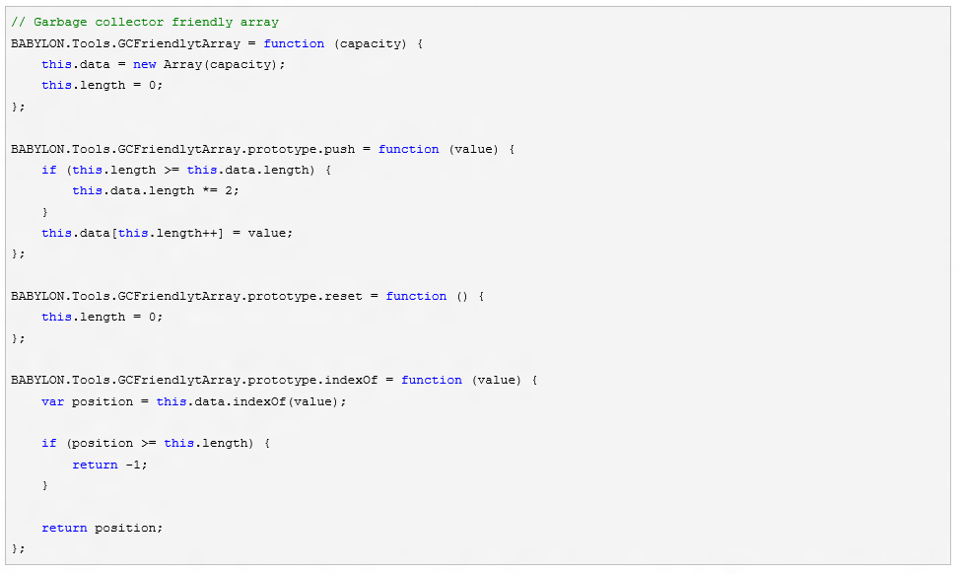
Reducing the pressure on the garbage collector
GC friendly array object

Slide 24
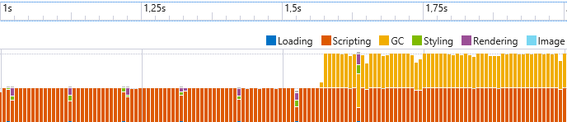
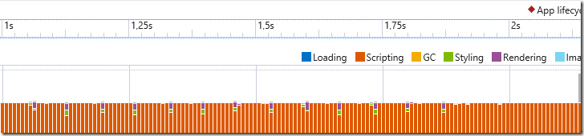
Reducing the pressure on the garbage collector
Results
Before:
After:

Slide 25
State caching
Changing a state (alpha blending, depth test, etc..) is expensive
What can we do?
Creating state objects on top of WebGL (depth states, alpha states)
WebGL states are only changed before an effective draw order

Slide 26
STATES MANAGEMENT
DEMO

Slide 27
Smart Shader
Shaders are compiled at runtime
We must ensure that shaders do not lost time
Try to avoid loops
Try to avoid conditions
Reduce instructions to minimal viable set

Slide 28
But also…
Minimize the number of active objects
Culling
Octrees
Frustum clipping
Maximize GPU work
Use shaders for non-rendering operations (particles)
Render to texture
Reduce the number of draw calls by grouping objects

Slide 29
Performance first
Going further
Reducing the pressure on the garbage collector by using the F12 developer bar of Internet Explorer 11
What do you mean by shaders? Learn how to create shaders with babylon.js

Slide 30
Section Four
Introducing Babylon.js

Slide 31

Babylon.js is: An average of 1 version per month 28 contributors 33 releases 592 commits 14000+ lines of code More than 120 files of code More than 250 forks A bandwidth of 1 TB per month for the website 1.3GB (Code and samples)

Slide 32

How to use Babylon.js?
Open source project (Available on Github)
http://www.babylonjs.com
https://github.com/babylonjs/babylon.js
How to use it? Include one file and you’re ready to go!
To start Babylon.js, you’ve just need to create an engine object:
<script src="babylon.js"></script>
var engine = new BABYLON.Engine(canvas, true);

Slide 33
How to use Babylon.js?
Babylon.js is a scene graph: All complex features are abstracted for YOU!
Handling rendering can be done in one line:
var scene = new BABYLON.Scene(engine);
var camera = new BABYLON.FreeCamera("Camera", new BABYLON.Vector3(0, 0, -10), scene);
var light0 = new BABYLON.PointLight("Omni0", new BABYLON.Vector3(0, 100, 100), scene);
var sphere = BABYLON.Mesh.createSphere("Sphere", 16, 3, scene);
engine.runRenderLoop(function() { scene.render(); });

Slide 34
Did you say features?
Complete scene graph with lights, cameras, materials and meshes
Collisions engine
Physics engine (thanks to cannon.js)
Scene picking
Antialiasing
Animations engine
Particles Systems
Sprites and 2D layers
Frustum clipping
Sub-meshes clipping
Hardware scaling
Selection octrees
Offline mode (Assets are saved locally to prevent reloading them)
Incremental loading
Hardware accelerated instances
Diffuse lightning and texture
Ambient lightning and texture
Specular lightning
Opacity texture
Reflection texture (Spheric, planar, cubic and projection)
Mirror texture
Emissive texture
Specular texture
Bump texture
Up to 4 lights (points, directionals, spots, hemispherics)
Custom materials
Skybox
Vertex color
4 bones per vertex
Fog
Alpha blending
Alpha testing
Billboarding
Fullscreen mode
Shadow Maps and Variance Shadow Maps
Rendering layers
Post-processes (blur, refraction, black'n'white, fxaa, customs...)
Lens flares
Multi-views
Render target textures
Dynamic textures (canvas)
Video textures
Compressed (DDS) textures
Arc rotate camera
Free camera
Touch camera
Virtual Joysticks camera
Oculus Rift camera
Gamepad camera
Mesh cloning
Dynamic meshes
Height maps
Bones
Constructive solid geometries
Babylon scene file can be converted from .OBJ, .FBX, .MXB
Exporter for Blender
Exporter for Cheetah3d
Exporter for 3ds Max
Support for drag'n'drop

Slide 35
Thank you to
All our community members with a very special thanks to:
Dad72
Gwenael
Temechon
Wingnut
Gryff
JCPalmer
Guillaume Pelletier

